Slide 1
Spring MVC

Slide 2
What is MVC
The Spring Web MVC framework provides Model-View-Controller (MVC) architecture and ready components that can be used to develop flexible and loosely coupled web applications. The MVC pattern results in separating the different aspects of the application (input logic, business logic, and UI logic), while providing a loose coupling between these elements.
The Model encapsulates the application data and in general they will consist of POJO.
The View is responsible for rendering the model data and in general it generates HTML output that the client's browser can interpret.
The Controller is responsible for processing user requests and building an appropriate model and passes it to the view for rendering.

Slide 3
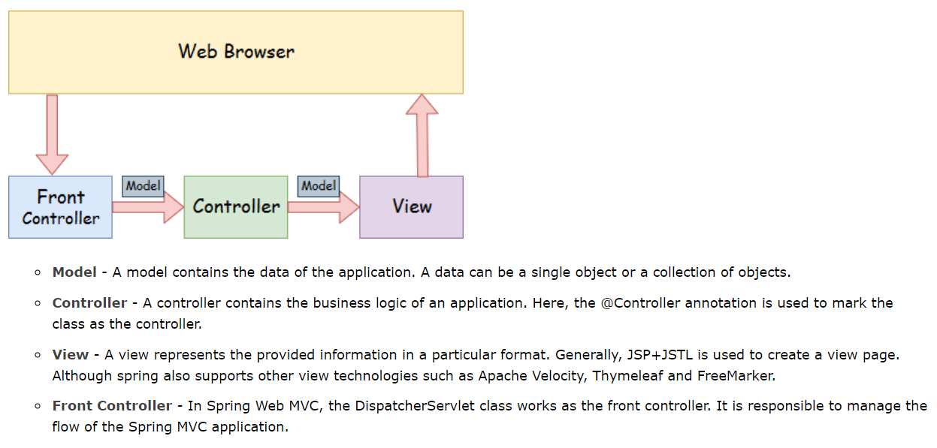
Spring MVC

Slide 4
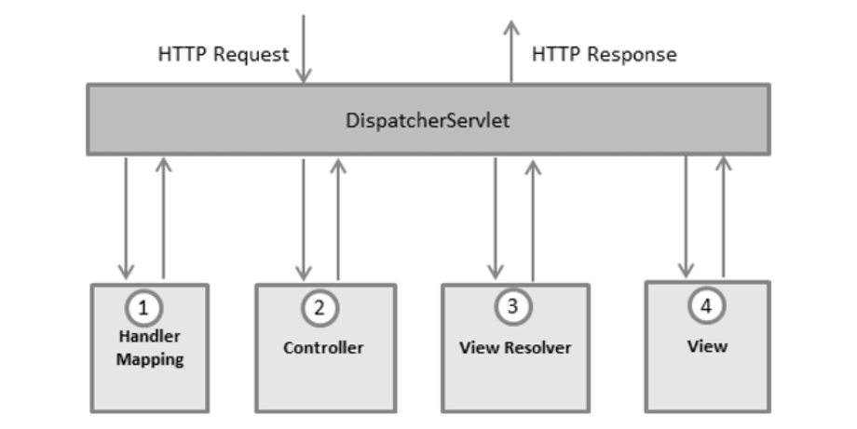
The Dispatcher Servlet
The Spring Web model-view-controller (MVC) framework is designed around a DispatcherServlet that handles all the HTTP requests and responses. The request processing workflow of the Spring Web MVC DispatcherServlet is illustrated in the following diagram −

Slide 5
Dispatcher Servlet
Following is the sequence of events corresponding to an incoming HTTP request to DispatcherServlet −
After receiving an HTTP request, DispatcherServlet consults the HandlerMapping to call the appropriate Controller.
The Controller takes the request and calls the appropriate service methods based on used GET or POST method. The service method will set model data based on defined business logic and returns view name to the DispatcherServlet.
The DispatcherServlet will take help from ViewResolver to pickup the defined view for the request.
Once view is finalized, The DispatcherServlet passes the model data to the view which is finally rendered on the browser.
All the above-mentioned components, i.e. HandlerMapping, Controller, and ViewResolver are parts of WebApplicationContext w which is an extension of the plainApplicationContext with some extra features necessary for web applications.

Slide 6
Install Apache Tomcat.
Download Apache Tomcat 7.0/8.0 and configure it with Eclipse.

Slide 7
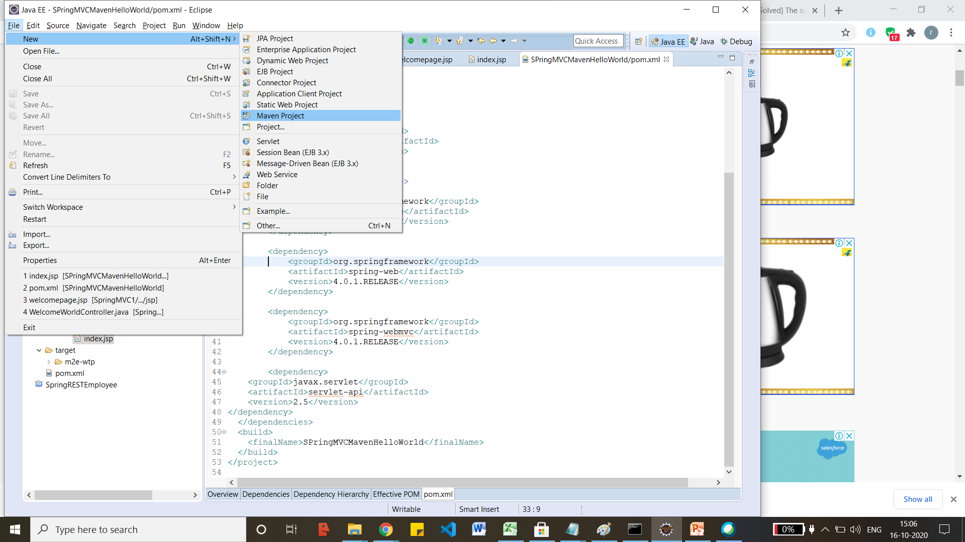
Spring MVC Hello world.
Create a maven project and click on next after clicking on Maven Project.

Slide 8
Maven Project
Click on maven-archtype-webapp and click on next and enter GroupID and ArtifactID as project name and click on Finish.
Add the following dependencies in pom.xml
<dependency>
<groupId>junit</groupId>
<artifactId>junit</artifactId>
<version>3.8.1</version>
<scope>test</scope>
</dependency>
<dependency>
<groupId>org.springframework</groupId>
<artifactId>spring-core</artifactId>
<version>4.0.1.RELEASE</version>
</dependency>
<dependency>
<groupId>org.springframework</groupId>
<artifactId>spring-web</artifactId>
<version>4.0.1.RELEASE</version>
</dependency>
<dependency>
<groupId>org.springframework</groupId>
<artifactId>spring-webmvc</artifactId>
<version>4.0.1.RELEASE</version>
</dependency>
<dependency>
<groupId>javax.servlet</groupId>
<artifactId>servlet-api</artifactId>
<version>2.5</version>
</dependency>

Slide 9
Run the maven project.
Right click on pom.xml, Run as → Maven clean and Maven build. This will download the necessary jar files.
Right click on index.html and run As → Run On server.

Slide 10
What is JMS
JMS (Java Message Service) is an API that provides the facility to create, send and read messages. It provides loosely coupled, reliable and asynchronous communication.
JMS is also known as a messaging service.
There are two types of messaging domains in JMS.
Point-to-Point Messaging Domain
Publisher/Subscriber Messaging Domain

Slide 11
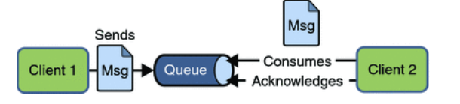
Point to Point.
Point-to-Point (PTP) Messaging Domain
In PTP model, one message is delivered to one receiver only. Here, Queue is used as a message oriented middleware (MOM).
The Queue is responsible to hold the message until receiver is ready.
In PTP model, there is no timing dependency between sender and receiver.

Slide 12
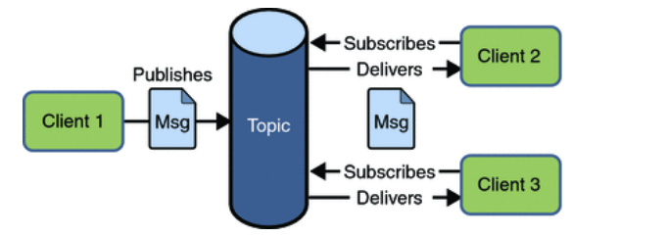
Publisher and Subscriber.
In Pub/Sub model, one message is delivered to all the subscribers. It is like broadcasting. Here, Topic is used as a message oriented middleware that is responsible to hold and deliver messages.
In PTP model, there is timing dependency between publisher and subscriber.

Slide 13
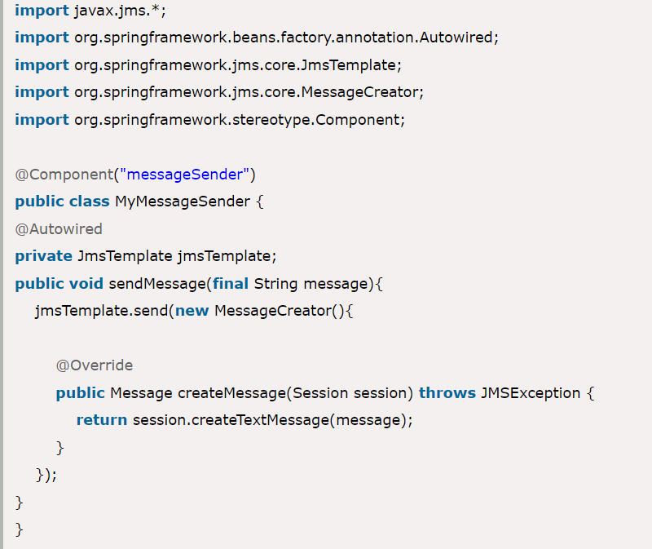
Send a message through JMS

Slide 14
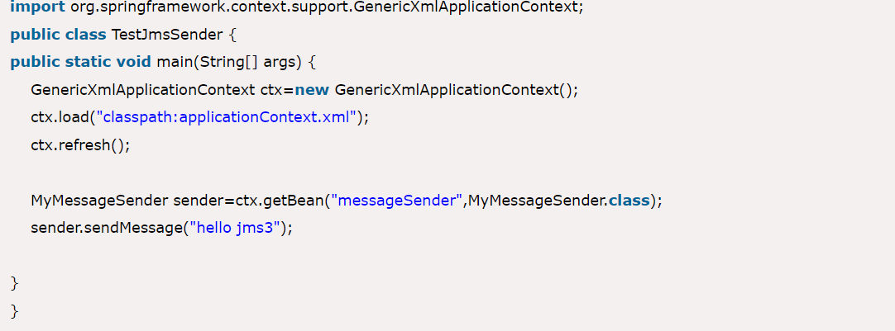
Main() which calls the component to send the message.

Slide 15
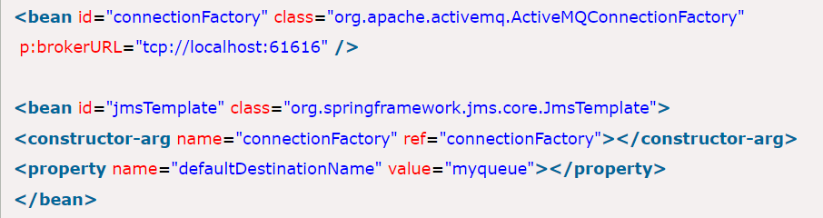
XML to specify about the component.

Slide 16
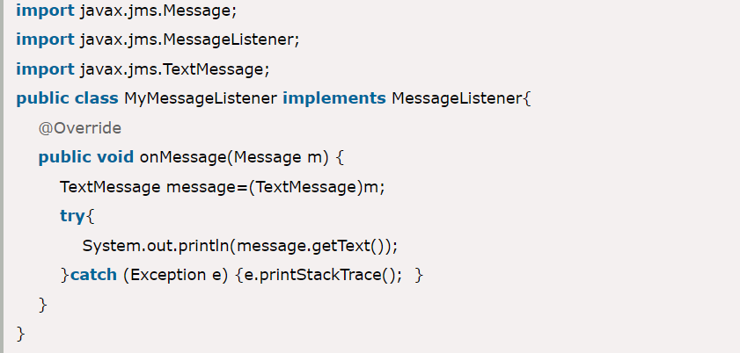
Receive the Message from JMS.

Slide 17
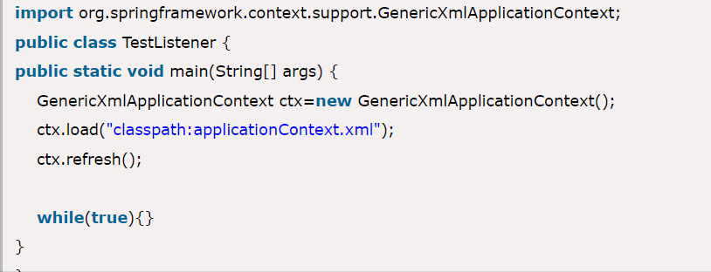
Message Listener.

Slide 18
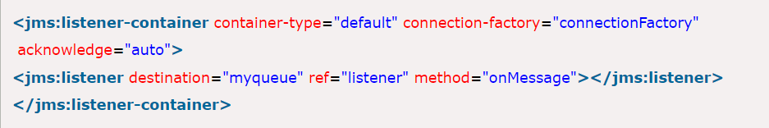
XML file for listener.
Also provide the listener file as given below:
<bean id="listener" class="MyMessageListener"></bean>

Slide 19
Thank you!

